Slide 1

Tribhuvan University
Butwal Multiple Campus
Introduction to Information Technology
TOPIC :-
Database Management System
@ Ayush Khatri
PRESENTING BY :
@ Binod Kandel
@ Bishal Bhattarai
@ Ritesh Pokhrel

Slide 2
CONTENT
INTRODUCTION
ELEMENT
CHARACTERISTICE
APPLICATION

Slide 3
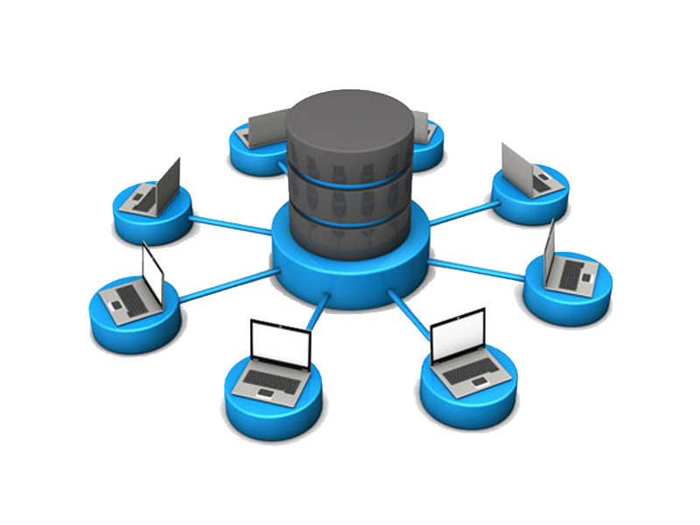
INTRODUCTION
DBMS stands for Database Management System.
DBMS is form by Database and Management System where as database means Collection of related data stored electronically in systematic Manner and management system means set of program to store and retrieve those data(present in database).
DBMS is a collection of data and set of program to access and store those data in an easy and efficient manner.
DBMS is a software which is used to manage relational database.

Slide 4

DATA
-> Collection of information.
FOR EXAMPLE:
Phone name
Battery backup
DATA
Price
processor

Slide 5
INTRODUCTION
DBMS stands for Database Management System.
DBMS is form by Database and Management System where as database means Collection of related data stored electronically in systematic Manner and management system means set of program to store and retrieve those data(present in database).
DBMS is a collection of data and set of program to access and store those data in an easy and efficient manner.
DBMS is a software which is used to manage related database.

Slide 6





RELATED DATA
Database

Slide 7
INTRODUCTION
DBMS stands for Database Management System.
DBMS is form by Database and Management System where as database means Collection of related data stored electronically in systematic Manner and management system means set of program to store and retrieve those data(present in database).
DBMS is a collection of data and set of program to access and store those data in an easy and efficient manner.
DBMS is a software which is used to manage relational database.

Slide 8
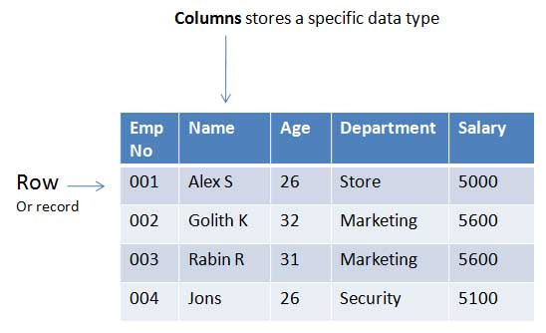
SYSTEMATIC MANNER
-> Storing data in form of table
Each contain data of employee

Slide 9
INTRODUCTION
DBMS stands for Database Management System.
DBMS is form by Database and Management System where as database means Collection of related data stored electronically in systematic Manner and management system means set of program to store and retrieve those data(present in database).
DBMS is a collection of data and set of program to access and store those data in an easy and efficient manner.
DBMS is a software which is used to manage relational database.

Slide 10
INTRODUCTION
DBMS stands for Database Management System.
DBMS is form by Database and Management System where as database means Collection of related data stored electronically in systematic Manner and management system means set of program to store and retrieve those data(present in database).
DBMS is a collection of data and set of program to access and store those data in an easy and efficient manner.
DBMS is a software which is used to manage relational database.

Slide 11
WORKING
It organizes our database files and provides end users more access and control over their data. To accomplish this, A DBMS allows users to manipulate the data in their database files, including creating, editing, and updating it when needed .

Slide 12
ELEMENT
ELEMENT
LOG MANAGER
REPORTING
&
MONITORING
QUERY PROCESSOR
STORAGE ENGINE

Slide 13
The storage engine is the core component of the DBMS that interacts with the file system at an OS level to store data. All SQL queries which interact with the underlying data go through the storage engine
Storage engine

Slide 14
This component will keep all the logs of the DBMS. These logs will consist of user logins and activity, database functions, backups and restore functions, etc. The log manager ensures all these logs are properly recorded and easily accessible
Log
manager

Slide 15
Reporting and monitoring tools are another standard component that comes with a DBMS. Reporting tools will enable users to generate reports while monitoring tools enable monitoring the databases for resource consumption, user activity, etc.
Reporting
&
Monitoring
tool

Slide 16
This is the intermediary between the user queries and the database. The query processor interprets the queries of users and makes them actionable commands that can be understood by the database to perform the appropriate functionality
Query
processor

Slide 17
CHARACTERISTICS
REAL WORLD ENTITY
EASE OF ACCESS
CHARACTER
SECURITY
STORE ANY KIND OF STRUCTURED

Slide 18
The DBMS is designed in such a way that it can cater to the needs of huge business organizations and can store large data with efficient operations on them. Database can store things like cost of vegetables or cost of different brands of breads etc.
REAL
WORLD
ENTITY

Slide 19
we can run a search query to find any data and the process is way faster then manual searching and is more reliable
EASE OF
ACCESS

Slide 20
The access to make changes to a database by the user is limited and the users not able to access entire database.
SECURITY

Slide 21
The DBMS is designed in such a way that it can cater to the needs of huge business organizations and can store large data with efficient operations on them. Database can store things like cost of vegetables or cost of different brands of breads etc.
STORE ANY KIND OF STRUCTURED

Slide 22
APPLICATION
HEALTH CARE
EDUCATION
APPLICATION
RAILWAY &
AIRLINE
BANKING

Slide 23
In healthcare industry, DBMS is used to store and manage patient records, medical histories, test results, and other health related data.
HEALYH
CARE

Slide 24
In education sector, DBMS is used to manage and organize student data, course details, library resources and activities that provides information in a well-mannered form.
EDUCATION

Slide 25
Records related to ticket booking, arrival time, departure time, delays, and seat numbers of airplanes and trains can be done by using DBMS.
RAILWAYS
&
AIRLINE

Slide 26
Thousands of new bank accounts, transactions and deposits are made on a daily basis through DBMS that keeps track of all the records in an efficient way.
BANKING

Slide 27
THANK YOU

